Slide 1
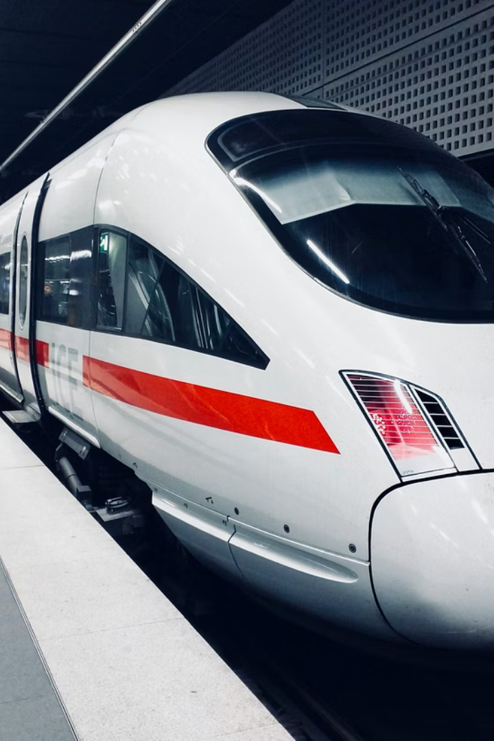
UK-train Analysis
This project focuses on analyzing UK-train data to optimize our performance and customer engagement.

Slide 2


Slide 3
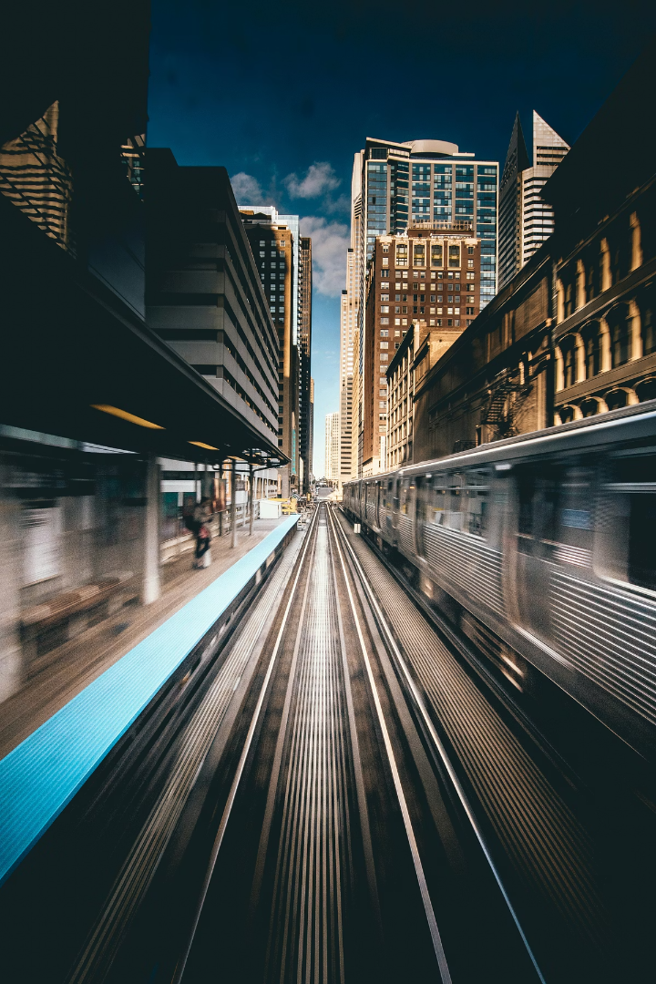
Project Objective
Sales and Revenue Analysis
Total revenue by ticket type, station, class, and railcard usage
Trend analysis of purchases over time (daily/weekly/monthly)
Passenger Behavior Insights
Distribution of purchase methods (Online vs Station)
Usage of payment methods
Railcard usage rates and impact on price
Route Analysis
Identify the most frequently traveled and highest-revenue routes to understand passenger demand and route profitability.
Evaluate route performance by analyzing on-time rates, delay reasons, and refund patterns to support service optimization.

Slide 4
Project Scope
Data Coverage:
Product Performance:
Orders Data:
Sales Trends:
Analyze 31,000+ ticket transactions including journey details, purchase behavior, ticket types, and performance metrics.
Examine purchase patterns by type (Online vs Station), payment method, and time of purchase.
Track daily, weekly, and monthly revenue trends.
Evaluate ticket types, classes, and railcard usage to determine which products (e.g., Advance vs Anytime, Standard vs First Class) perform best in terms of volume and revenue.
Identify peak purchase and travel times, and seasonal variations in ticket sales.
Monitor order distribution across stations, dates, and refund occurrences for operational insights.
Analyze on-time vs delayed journeys.

Slide 5
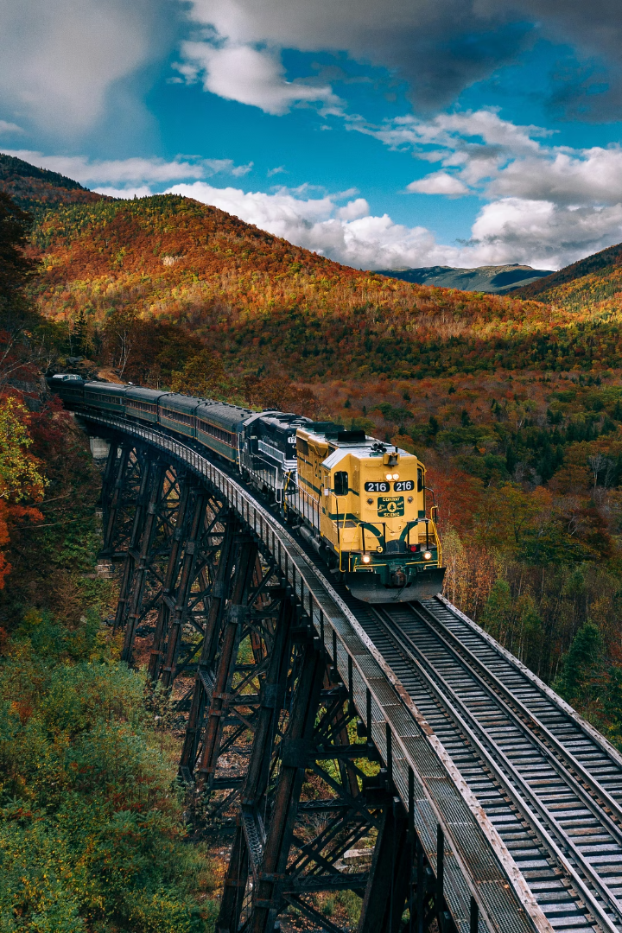
Analysis steps
Data Cleaning
Use Power query to clean and structure raw data for analysis.
Exploratory Analysis
Derive insights on customer behavior and product trends and using DAX measures to optimize performance.
Dashboard Development
Build interactive Power-bi dashboards for clear performance views and improve story telling.

Slide 6
Deliverables
1. Journey and Service Performance
2. Ticket and Passenger Insights
Total journeys: 31,653 (Jan–Apr 2024); 1,880 cancelled.
Standard class: 90% of all tickets sold.
Advance tickets are the most popular within Standard class.
January saw the highest journey volume (7,636); February the lowest (7,212), a -4.36% decrease.
Railcard usage: 2/3 of passengers do not use a railcard.
On-time performance: 18,019 on-time; 1,062 delayed; 790 cancelled.
Adult railcard is most used (16% of total passengers).
Cancellation rate: 4%.
Peak travel periods: 6–9 AM & 4–7 PM.

Slide 7
Deliverables
Delay and Refund Behavior
Revenue and Refund Trends
Shorter delays (≤1 min): High refund rate (64–76%)
Total net revenue: £703K; Refunds: £39K.
Delays 30–60 min: Most common, total 46,396 delay minutes, refund rate 11%
Revenue trend:
January: £188K
Delays >60 min: 0% refund rate
February: £151K (-20%)
Some 0-min delays still received refunds → policy inconsistency
March: £185K
Ticket type revenue:
Advance: £294K
Anytime: £200K
Off-Peak: £209K
Advance ticket revenue rose 40% in February despite overall revenue drop.
Revenue by journey status:
On-time: £570K (81%)
Delayed: £101K
Cancelled: £33K

Slide 8
Recommendations
1. Optimize Peak-Time Operations
Add more train capacity or frequency during peak slots (6–9 AM & 4–7 PM) to reduce congestion and improve customer experience.
Deploy real-time monitoring and resource reallocation for high-traffic time slots like 6:30 AM and 6:45 PM.
2. Reduce Cancellations and Delays
Invest in signal system upgrades and preventive maintenance to reduce failures, the top cause of cancellations.
Improve staff scheduling and training to address staffing-related disruptions.
Implement weather-resilient infrastructure (e.g., track heating, drainage systems) to handle seasonal disruptions.

Slide 9
Recommendations
3. Set refund Policy
A structured, fair refund model is proposed:
No refund for delays under 15 minutes
25% refund for delays 15–30 minutes
50% refund for delays 30–60 minutes
100% refund for delays over 60 minutes
4. Boost Railcard Usage and Loyalty Programs
Encourage railcard adoption through targeted promotions or bundling with frequent traveler incentives, as 2/3 of passengers currently do not use one.
Track railcard effectiveness in improving sales and loyalty.

Slide 10
Recommendations
5. Increase the number of trains during peak time and close the door after a certain time to avoid delays.
6. Raise the ticket prices from Manchester to Liverpool.
7. It’s not allowed to cancel when only 3 days are left before the trip.

Slide 11
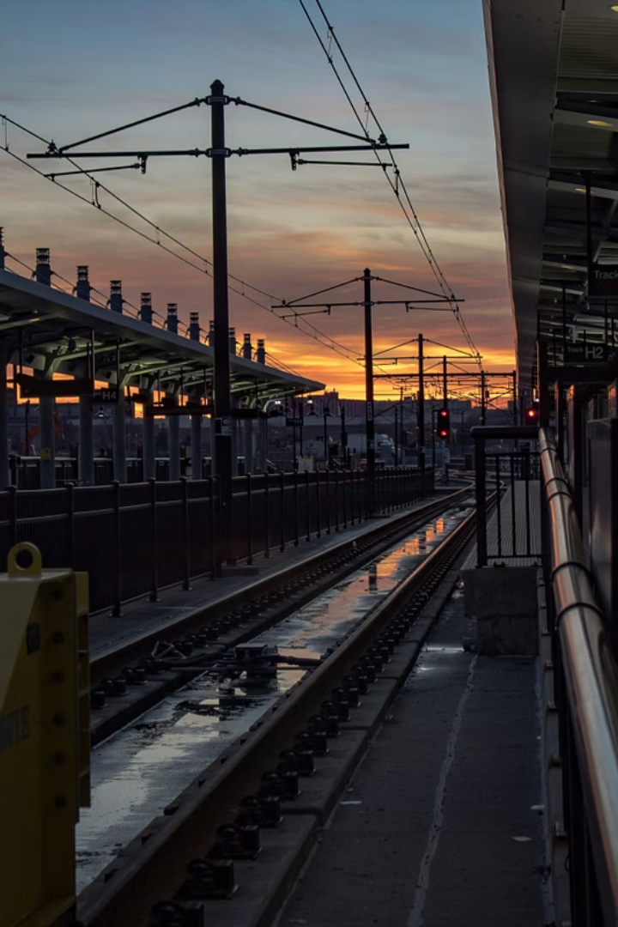
Thank You!

